Slide 1
Advanticsys
Weekly update – 17/03/2023
Topics to discuss:
Proposal for abnormal detection process
Methodology and visualization
Align data use for project

Slide 2
Abnormal detection process
Compare production in each inverter – check performance vs Average
Abnormal(>5%)
Check performance vs expectation based on UV/Temp
Abnormal(>5%)
Check performance vs past energy generation (identify patterns over time)
Within expectation
Normal
Within average
Normal
Off track
List as abnormal
Follow the pattern
Normal
Step 1
Assumptions:
Data available is on an inverter basis
Solar panels with same specifications relate to each inverter. (By this we mean the configuration of each inverter is identical)
The tolerance for considering abnormality is set to 5%. (Please advise us if this is not acceptable)
Solar panels at the start are non faulty ones.
Step 2
Step 3

Slide 3
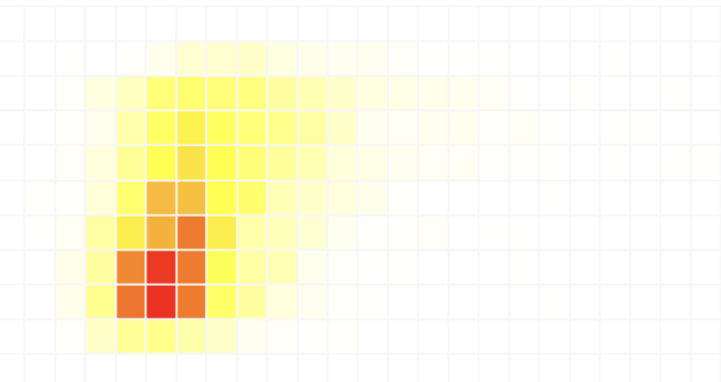
Step 1 – Compare production in different inverters.
Methodology and visualization
Less power generated
Generation of a heatmap based on the power generated in different inverters at a point of time.
The color strength is corresponding to the amount of power generated in each inverter.
more power generated

Slide 4


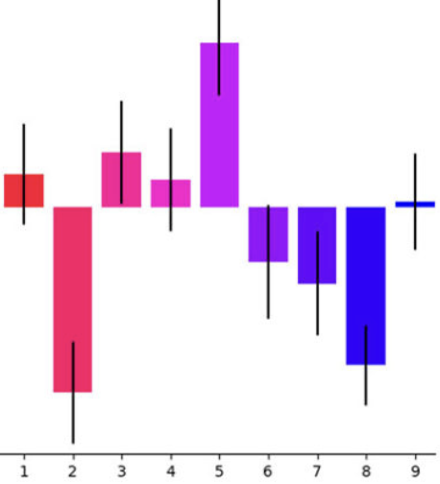
Step 2 – compare actual performance vs expectation.
Methodology and visualization
Correlating irradiance/Temp, use models to predict performance for each inverter based on historical data.
Compare actual vs prediction to identify abnormal
Can be viewed by using bar chart. Use prediction as base line. Show covariance between actual and prediction for each inverter

Slide 5
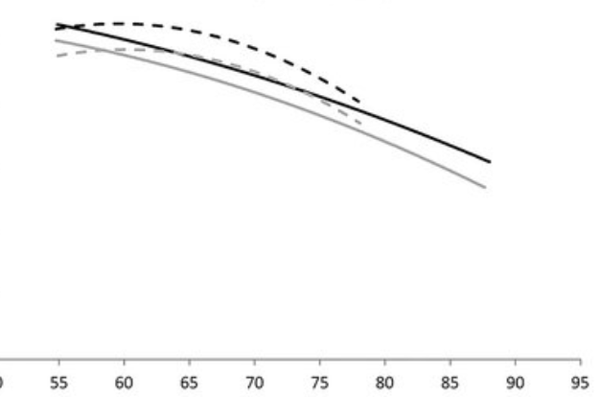
Step 3 – Check performance vs past energy generation
Methodology and visualization (Contd.)
Identify life span and capacity decline pattern based on historical data for similar panels/equipment
Compare actual against pattern to identify abnormal (line chart)

Slide 6
Summary:
Abnormal
Actual: 50kwh
Average: 60kwh
Act vs Ave: -10kwh
Prediction: 60kwh
Act vs Pred: -10kwh
Capacity: 60kwh
Act vs Capacity: -10kwh
Normal
Actual: 50kwh
Average: 60kwh
Act vs Ave: -10kwh
Prediction: 55kwh
Act vs Pred: -5kwh
Capacity: 50kwh
Act vs Capacity: 0kwh

Slide 7
Data generation and validation
What data is available
Energy data
frequency of data generation, daily, weekly or longer interval
Level of details – panel, group of panels
Is irradiance/Temperature data available
If yes, where can we get the data
If not
what level of details do we need to consider for model evaluation
How can we align public meteorology data with historical data

